Slide 1
EMBRYOLOGY OF THE AXIAL SKELETON
J.G Njoroge
Bsc Anat

Slide 2
OUTLINE
Components of the axial skeleton
Forms of ossification
Development of vertebrae
Development of the ribs and sternum
Congenital anomalies

Slide 3
AXIAL SKELETON COMPONENTS
Ribs
Sternum
Vertebral column
Skull

Slide 4
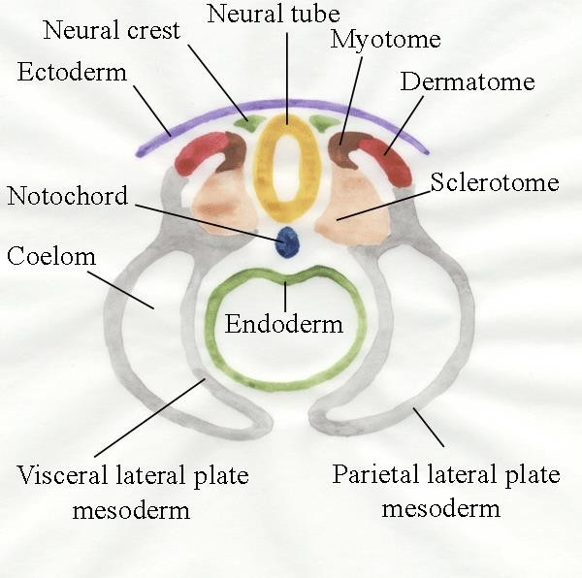
Development of the Skeletal System
Source of Origin:
Paraxial Mesoderm
Lateral plate Mesoderm
Neural Crest Cells
Paraxial mesoderm forms a segmented series of tissue blocks on each side of the neural tube , the ‘Somites’.
These somites differentiate into a;
Sclerotome, (ventromedial part)
Dermomyotome, (dorsolateral part )

Slide 5
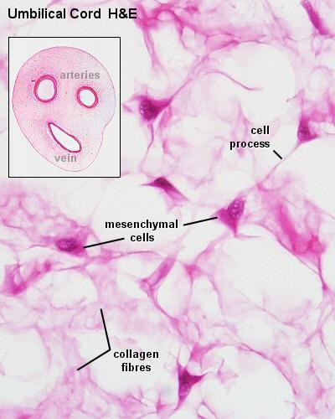
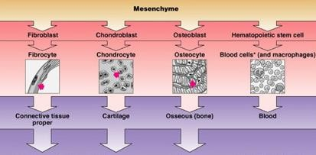
The Embryonic connective tissue
Mesenchyme or the embryonic connective tissue is a gelatinous substance with ‘star-shaped’ mesenchymal cells.
The mesenchymal cells migrate & differentiate into many different types of primitive cell lines, such as;
Fibroblasts (adult conn. Tissue forming cells),
Chondroblasts (cartilage forming cells),
Osteoblasts (bone forming cells).

Slide 6
Ossification
“The process of bone formation is known as ossification”
Bone develops during the intra uterine life through two types of ossifications;
Membranous type, in which the mesenchymal tissue (jelly-like) will directly transform into bone. (e.g. flat bones of skull)
Intra-cartilagenous type, in which the mesenchymal tissue first give rise to a hyaline cartilage model of the bone, then the osteoblasts will convert that model into bone (e.g. long bones, irregular bones like vertebrae etc)

Slide 7
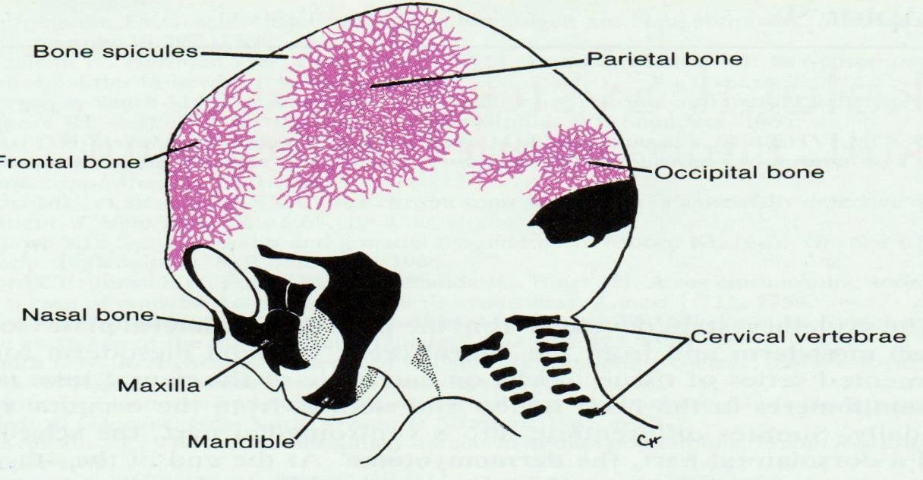
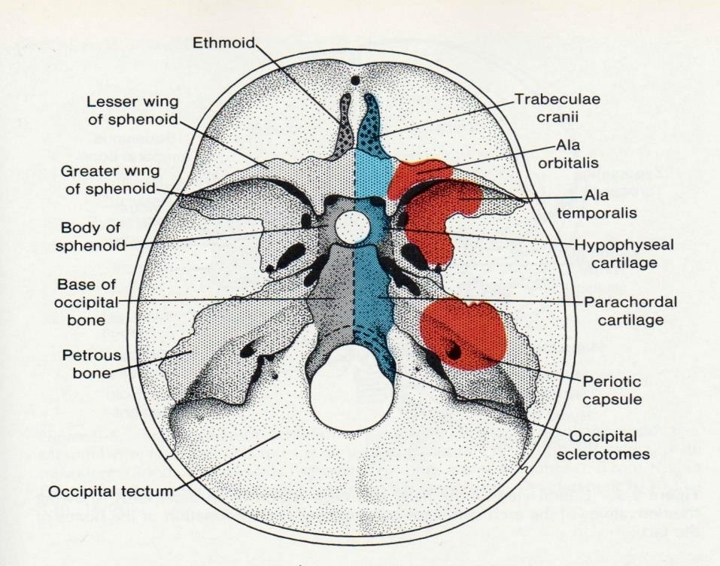
Development of Skull (Intramembranous Ossification)
The skull is divided into two parts;
Neurocranium which forms a protective covering around the brain is derived from the ‘occipital somites’
Membranous Neurocranium is composed of flat bones of the cranial vault.
Cartilagenous Neurocranium is composed of the irregular bones of the base of skull
Viscerocranium which forms the skeleton of the face is derived from the ‘Neural crest cells’.

Slide 8
Intracartilagenous (endochondral) Ossification
Mostly seen in the long bones of limbs.
First a hyaline cartilage model is formed in the mesenchyme (chondrification centers)
Then a primary ossification center appears in the ‘diaphysis’ of the model.
Bone formation/laying starts from the center in both upward & downward direction.
Almost all primary centers of ossification appear before birth.
Most of the secondary centers appear after birth.
The part of a long ossified from Primary center is the ‘Diaphysis’
The part of a long bone ossified from a secondary center is the ‘Epiphysis’
The fusion between the diaphysis and epiphysis does not occur till puberty

Slide 9
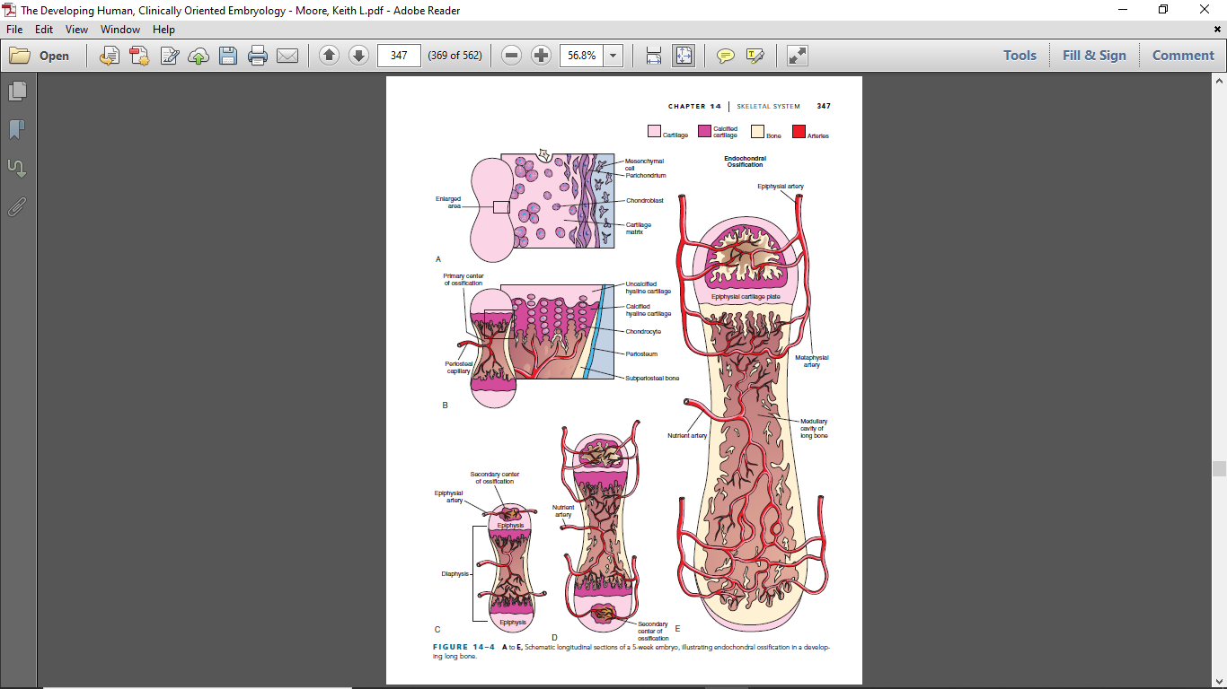

Slide 10
DEVELOPMENT OF THE VERTEBRAL COLUMN
Each sclerotome consists of loosely arranged cells cranially and densely packed cells caudally.
Some densely packed cells move cranially, opposite the center of the myotome, where they form the annulus fibrosus of intervertebral (IV) disc.
The remaining densely packed cells fuse with the loosely arranged cells of the immediately caudal sclerotome to form the mesenchymal centrum, the primordium of the body of a vertebra.
Between the vertebrae, the notochord expands to form the gelatinous center of the IV disc—the nucleus pulposus.
The mesenchymal cells, surrounding the neural tube, form the neural arch, that is, the primordium of vertebral arch. The mesenchymal cells in the body wall form costal processes, which form the ribs in the thoracic region.

Slide 11
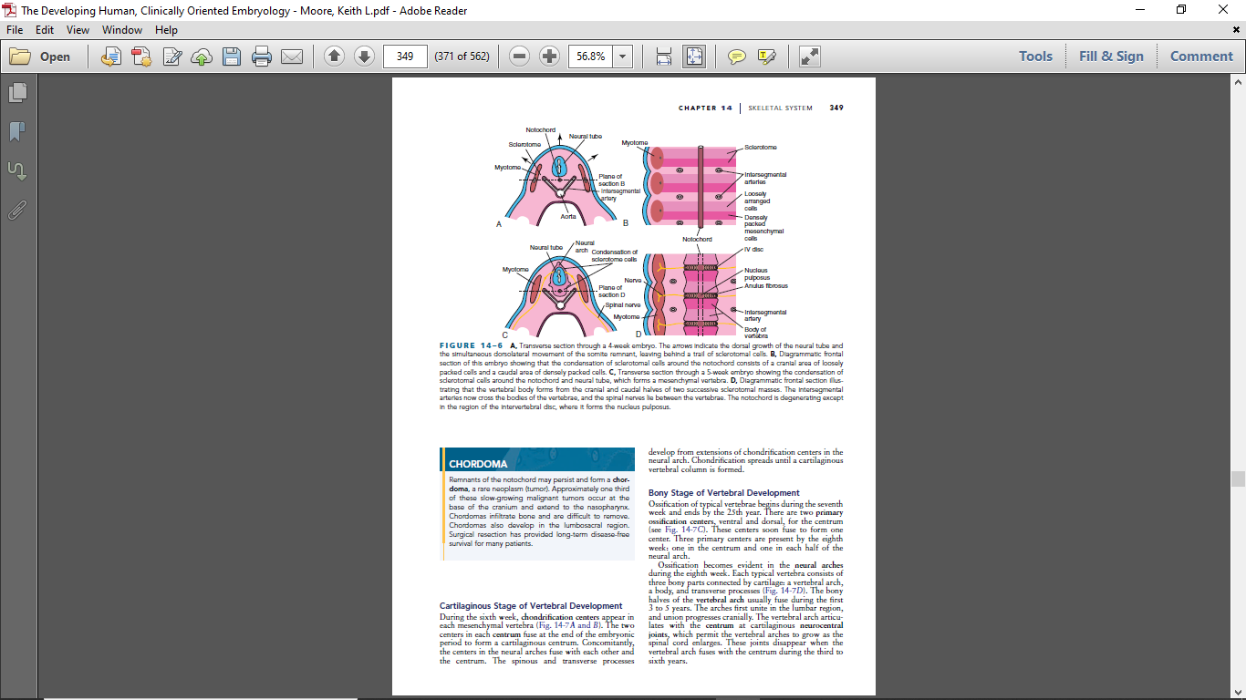

Slide 12
VERTEBRAL COLUMN CONT.
During the sixth week, chondrification centers appear in each mesenchymal vertebra .The two centers in each centrum fuse at the end of the embryonic period to form a cartilaginous centrum.
Concomitantly, the centers in the neural arches fuse with each other and the centrum. The spinous and transverse processes develop from extensions of chondrification centers in the neural arch. Chondrification spreads until a cartilaginous vertebral column is formed.

Slide 13
VERTEBRAL COLUMN CONT.
Ossification of typical vertebrae begins during the seventh week and ends by the 25th year. There are two primary ossification centers, ventral and dorsal, for the centrum. These centers soon fuse to form one center.
Three primary centers are present by the eighth week: one in the centrum and one in each half of the neural arch.
Ossification becomes evident in the neural arches during the eighth week. Each typical vertebra consists of three bony parts connected by cartilage: a vertebral arch, a body, and transverse processes (The bony halves of the vertebral arch usually fuse during the first3 to 5 years.
The arches first unite in the lumbar region, and union progresses cranially.
The vertebral arch articulates with the centrum at cartilaginous neurocentraljoints, which permit the vertebral arches to grow as the spinal cord enlarges. These joints disappear when the vertebral arch fuses with the centrum during the third to sixth years.

Slide 14
VERTEBRAL COLUMN CONT.
Five secondary ossification centers appear in the vertebrae after puberty:
l One for the tip of the spinous process
l One for the tip of each transverse process
l Two annular epiphyses, one on the superior and one on the inferior rim of the vertebral body
All secondary centers unite with the rest of the vertebrae at approximately 25 years of age.
Exceptions to the typical ossification of vertebrae: in the atlas or C1vertebra, axis or C2 vertebra, C7 vertebra, lumbar vertebrae,sacrum, and coccyx.

Slide 15
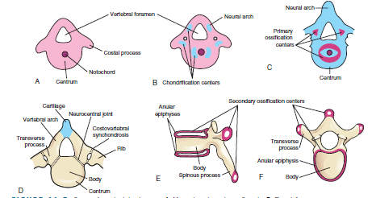

Slide 16
RIB DEVELOPMENT
The ribs develop from the mesenchymal costal processes of the thoracic vertebrae. They become cartilaginous during the embryonic period and ossify during the fetal period.
The original site of union of the costal processes with the vertebra is replaced by costovertebral synovial joints . Seven pairs of ribs (1–7)—true ribs—attach through their own cartilages to the sternum. Five pairs of ribs (8–12)—false ribs—attach to the sternum through the cartilage of another rib or ribs.
The last two pairs of ribs (11 and 12)—floating ribs—do not attach to the sternum.

Slide 17
DEVELOPMENT OF THE STERNUM
A pair of vertical mesenchymal bands, sternal bars, develop ventrolaterally in the body wall. Chondrification occurs in these bars as they move medially.
By 10 weeks, they fuse craniocaudally in the median plane to form cartilaginous models of the manubrium, sternebrae (segments of sternal body), and xiphoid process.
Centers of ossification appear craniocaudally in the sternum before birth, except that for the xiphoid process, which appears during childhood.

Slide 18
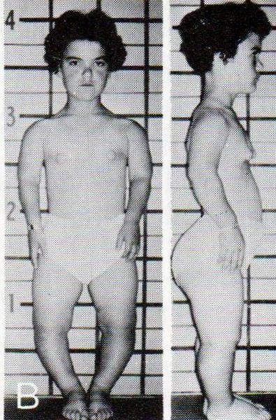
AXIAL Skeletal system Anomaly
Achondroplasia:
Caused by a disturbance in the
‘endochondral/intracartilagenous’ ossification in the ‘epiphyseal/growth plates’ of the long bones.
The result is Dwarfism.
Both extremities are short but head is of normal size.

Slide 19
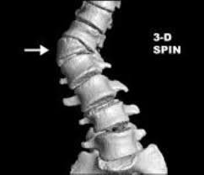
Hemivertebra
A hemivertebra results from failure of one of the chondrification centers to appear and subsequent failure of half of the vertebra to form.
Hemivertebrae are the most common cause of congenital scoliosis (lateral and rotational curvature) of the vertebral column.

Slide 20
KLIPPEL-FEIL SYNDROME
The main features of this syndrome are shortness of the neck, low hairline, and restricted neck movements, fusion of cervical vertebral bodies and abnormalities of the brainstem and cerebellum.
In most cases, the number of cervical vertebral bodies is fewer than normal due to fusion of vertebrae before birth. In some cases, there is a lack of segmentation of several elements of the cervical region of the vertebral column. The number of cervical nerve roots may be normal but they are small, as are the intervertebral foramina.
Individuals with this syndrome may have other birth defects, including scoliosis(abnormal lateral and rotational curvature of the vertebral column) and urinary tract disorders.

Slide 21
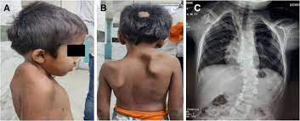
KLIPPEL-FEIL SYNDROME

Slide 22
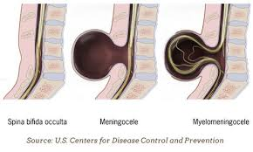
SPINA BIFIDA

Slide 23
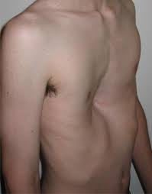
PECTUS EXCAVATUM

Slide 24
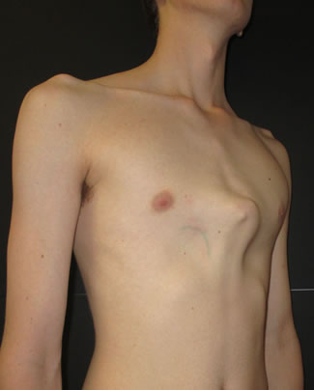
PECTUS CARINATUM

Slide 25

The list of anomalies shown here is not exhaustive.

Slide 26
THANK YOU

